Slide 1
Charting career paths for Educators in PASUM

Slide 2
Why career planning matters?
Lead to professional growth
Job satisfaction
Personal fulfillment

Slide 3
Statistics on career planning
According to a Gallup survey, employees who feel they have a clear career path in their organization are 2.5 times more likely to feel satisfied with their jobs.
Research conducted by the Society for Human Resource Management (SHRM) indicates that employees who have a clear understanding of their career goals are more likely to perform at higher levels and contribute effectively to their organizations.
A study by Harvard Business Review revealed that individuals who engage in career planning are more likely to receive promotions and advancement opportunities throughout their careers.
According to the U.S. Bureau of Labor Statistics, individuals with higher levels of education and better career planning tend to earn higher salaries over the course of their careers.

Slide 4
Experience + strong foundation in teaching
Now what's next?

Slide 5
Innovation in teaching
Modify the current continuous assessment
Effective teaching approach
Impart technology

Slide 6
2. Exploring academic leadership

Slide 7
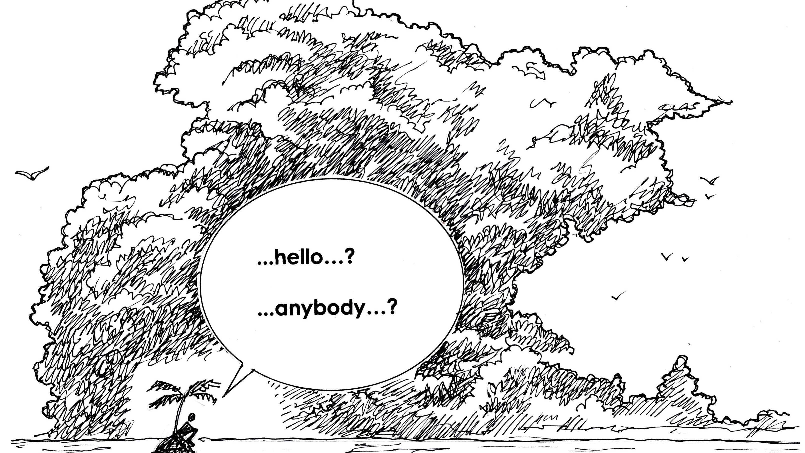
3. Specialization, research and visibility

Slide 8
4. Transition in education

Slide 9
5. Continuous professional development
So you don’t get rusty !!!!
Conferences
Upskilling: Workshops / courses / certification

Slide 10
6. Mentoring and coaching

Slide 11
Conclusion
Take action towards charting their own career paths!
Better now than never

Slide 12
Resources
Opportunities for professional growth, access to research, networking, and practical strategies for educators looking to plan and develop their careers.

Slide 13
Professional Associations:
Association of Professional in Curriculum and Educational Instruction (https://aproceimalaysia.com/)
Malaysian English Language Teaching Association (MELTA) (https://www.melta.org.my/index.html )
Society of Engineering Education in Malaysia (https://www.seem.my/ )
International Association of Educators (https://inased.org/ )
International Association for Educators and Researchers (https://www.theiaer.org/ )
Association of International Educators (https://www.nafsa.org/ )

Slide 14
2. Websites and Online Platforms:
Teach.com: teach.com
Education Week: edweek.org
Edutopia: edutopia.org
Teaching Channel: teachingchannel.org
TED-Ed: ed.ted.com
Coursera: coursera.org (offers online courses on education-related topics)

Slide 15
3. Books
"The First-Year Teacher's Survival Guide" by Julia G. Thompson
"The New Art and Science of Teaching" by Robert J. Marzano
"The Courage to Teach: Exploring the Inner Landscape of a Teacher's Life" by Parker J. Palmer
"Teach Like a Champion 2.0: 62 Techniques That Put Students on the Path to College" by Doug Lemov
"Visible Learning for Teachers: Maximizing Impact on Learning" by John Hattie
"Mindset: The New Psychology of Success" by Carol S. Dweck

Slide 16
4. Professional Development Programs:
National Board Certification for Teachers: nbpts.org
Google for Education Teacher Center: teachercenter.withgoogle.com
Project Zero Classroom: pz.harvard.edu/projects/project-zero-classroom
International Baccalaureate (IB) Professional Development: ibo.org/professional-development

Slide 17
Thank you

