Slide 1
Research Initiatives in PASUM
&
Sharing Session for PjPBL Project
Amirul Mohamad Khairi bin Mannan
29 May 2023
Pullman Hotel, Bangsar, KUALA LUMPUR

Slide 2
Process Diagrams
Crucial to get you moving!
01
Motivation
Life is like a wheel. Make a good one!
Create Cycle
02
Repetition is King!
03
Repeat Process
Reward yourself!
Rewards
04

Slide 3
Start
Where you are
01 Motivation
Use
04
What you have
Great things TAKE TIME
Do
03
What you can
02
Never
01
Give up

Slide 4
02
Create Cycle:
Semester 1
Execute
Plan
Plan - we all plan what to teach every new semester
Execute - then we implement
Feedback - we get students response
Prepare - then we prepare report
WHY NOT CHANGE IT INTO SOMETHING REWARDING?
AFTER ALL WE WORK REALLY HARD..
01
03
This is ME
Feedback
Prepare
04

Slide 5
02
Create Cycle:
Semester 2
Copyright
Participate
Participate - in PIITRAM (sponsored by PASUM :) )
Copyright - with UMRC
Write - article
Present - at conference
REWARD YOURSELF WITH A MEDAL, A COPYRIGHT, AN ARTICLE AND PRESENT AT A CONFERENCE
01
03
This is ME & my Team
Write
Present
04

Slide 6
Repeat Process
Sem 1
Sem 2
Feedback & Preparation
Writing & Conference
Sem 1
Sem 2
Break
Plan & Execute
Competition & Copyright
You earned it!

Slide 7
Get Rewarded! Don’t wait for APC, SPC, ACUM..etc
ARTICLE
01
04
1 proceeding/ journal
CONFERENCE
COPYRIGHT
See outside world
1 copyright
AWARD
02
Others:
Toray Award
Sulam
Teaching grant
03
1 gold award

Slide 8
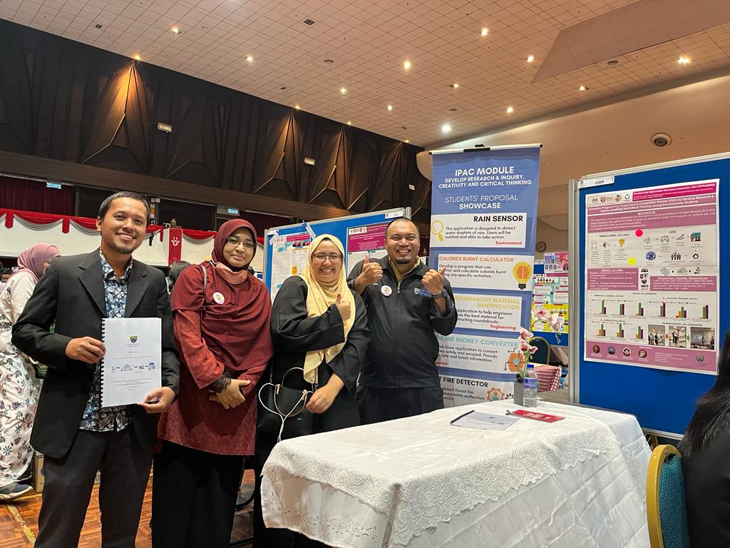
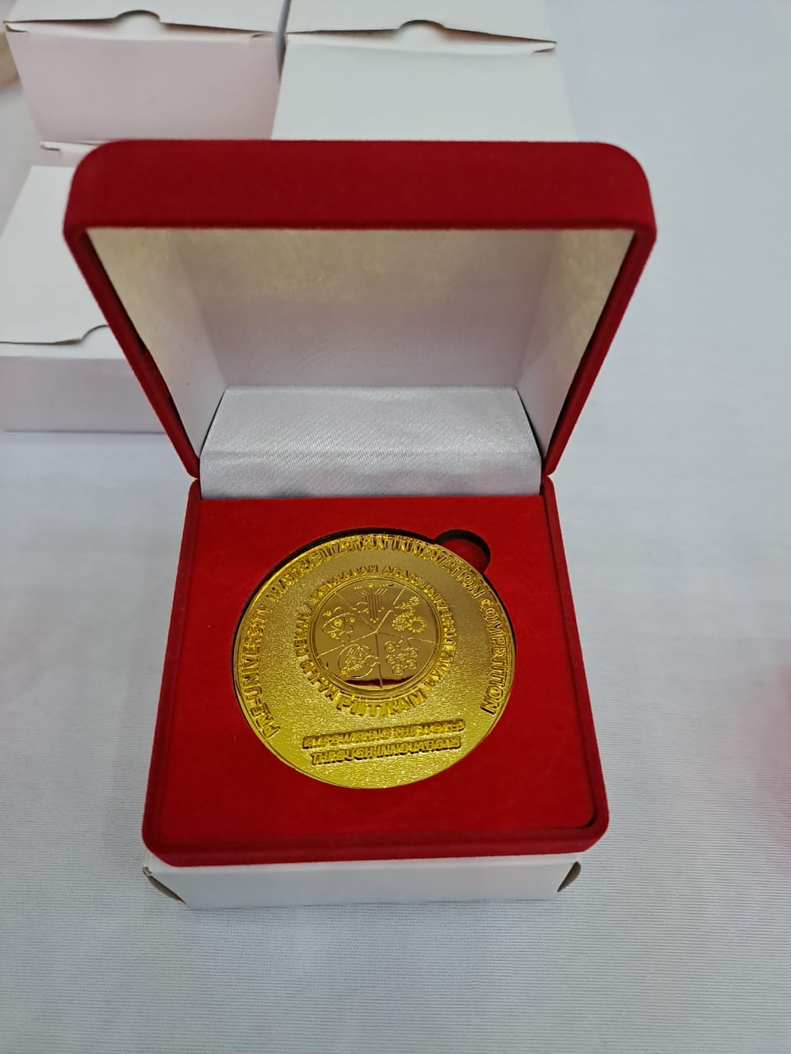

Slide 9
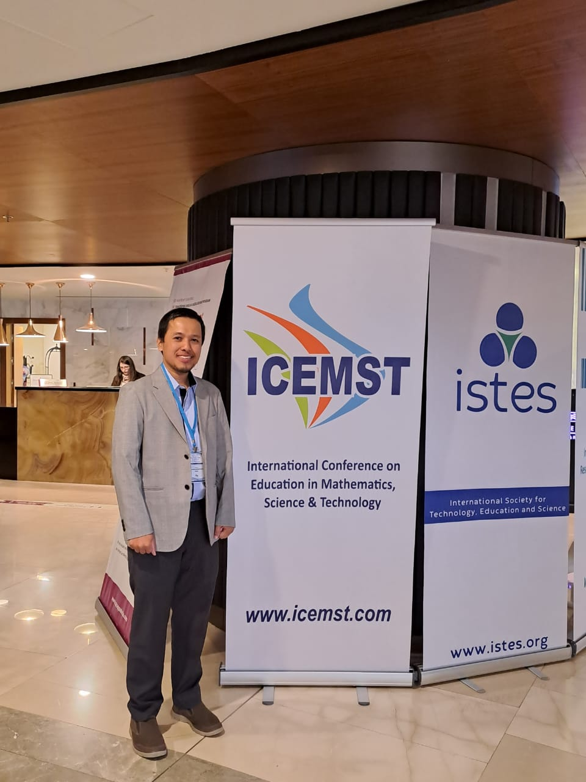
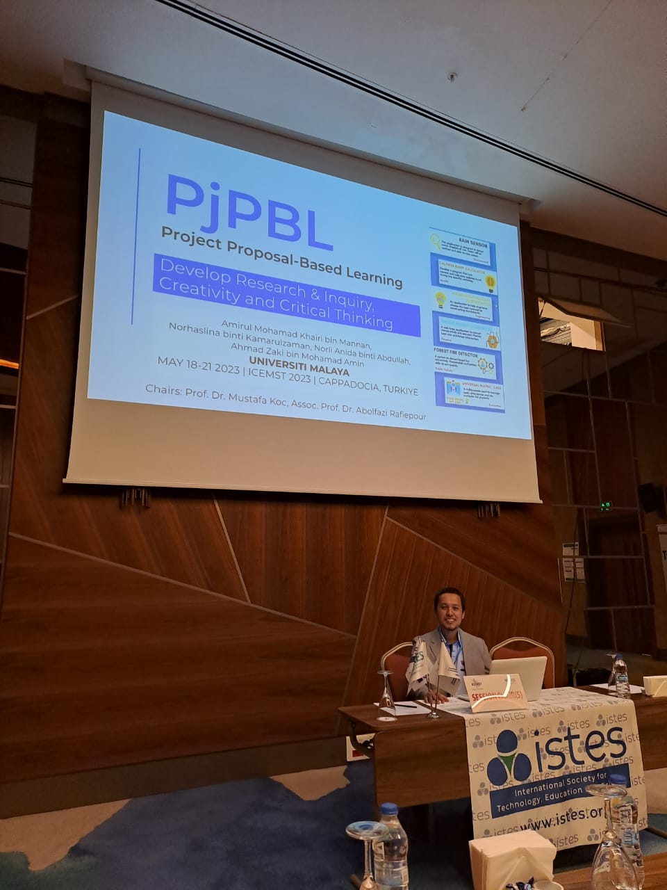
Sharing on
PjPBL (Project Proposal-Based Learning)

